Slide 1


www.aroncoin.live

Slide 2
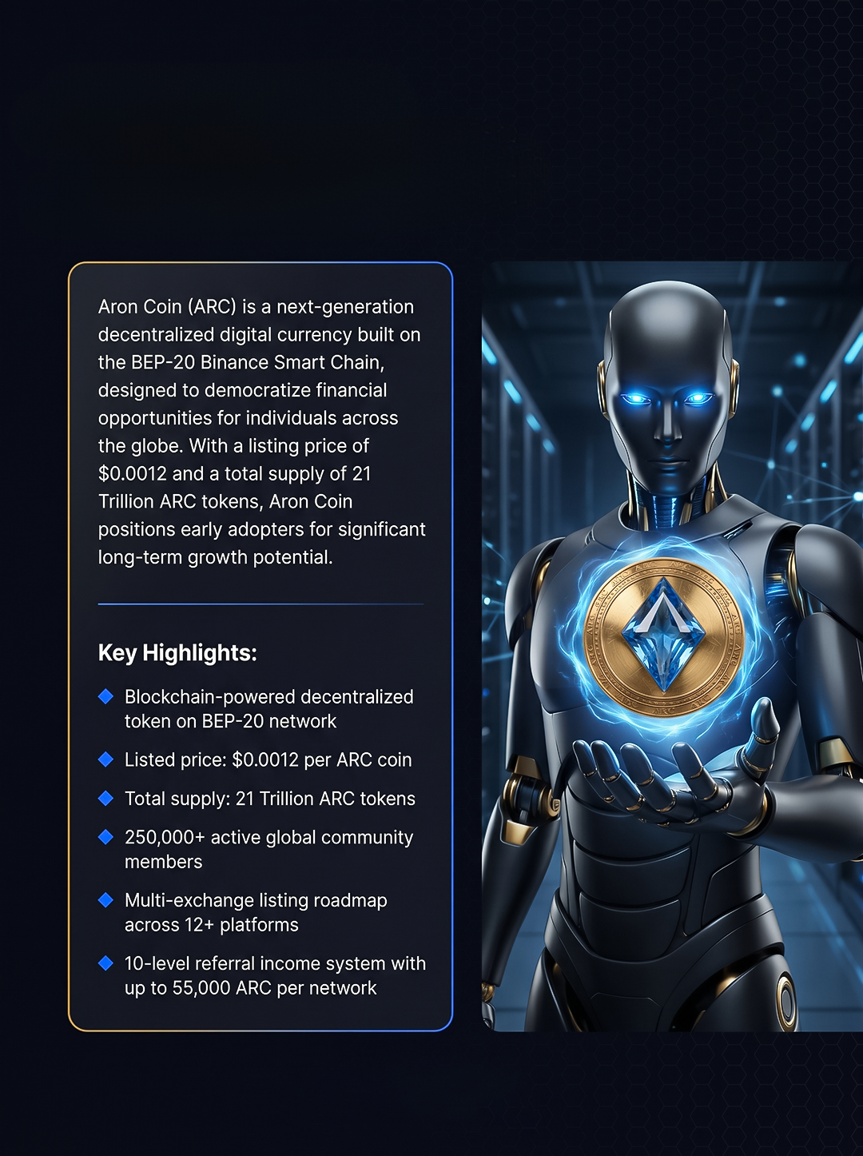
About Us
www.aroncoin.live

Slide 3

Mission & Vision
www.aroncoin.live

Slide 4
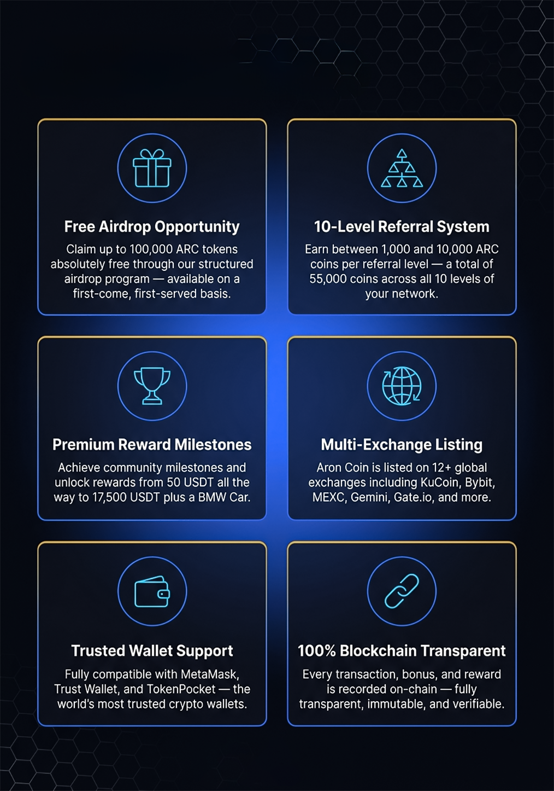
Features
www.aroncoin.live

Slide 5
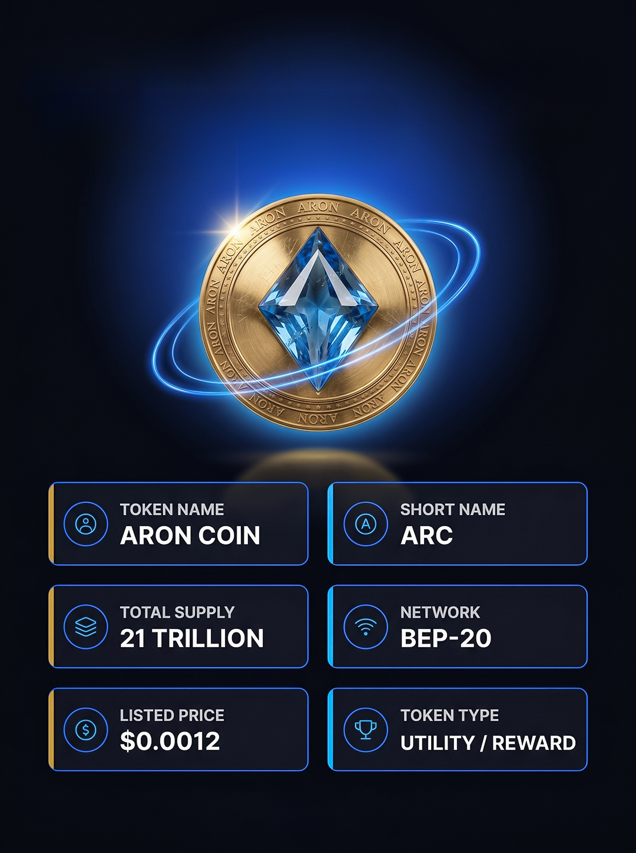
Token Overview
www.aroncoin.live

Slide 6
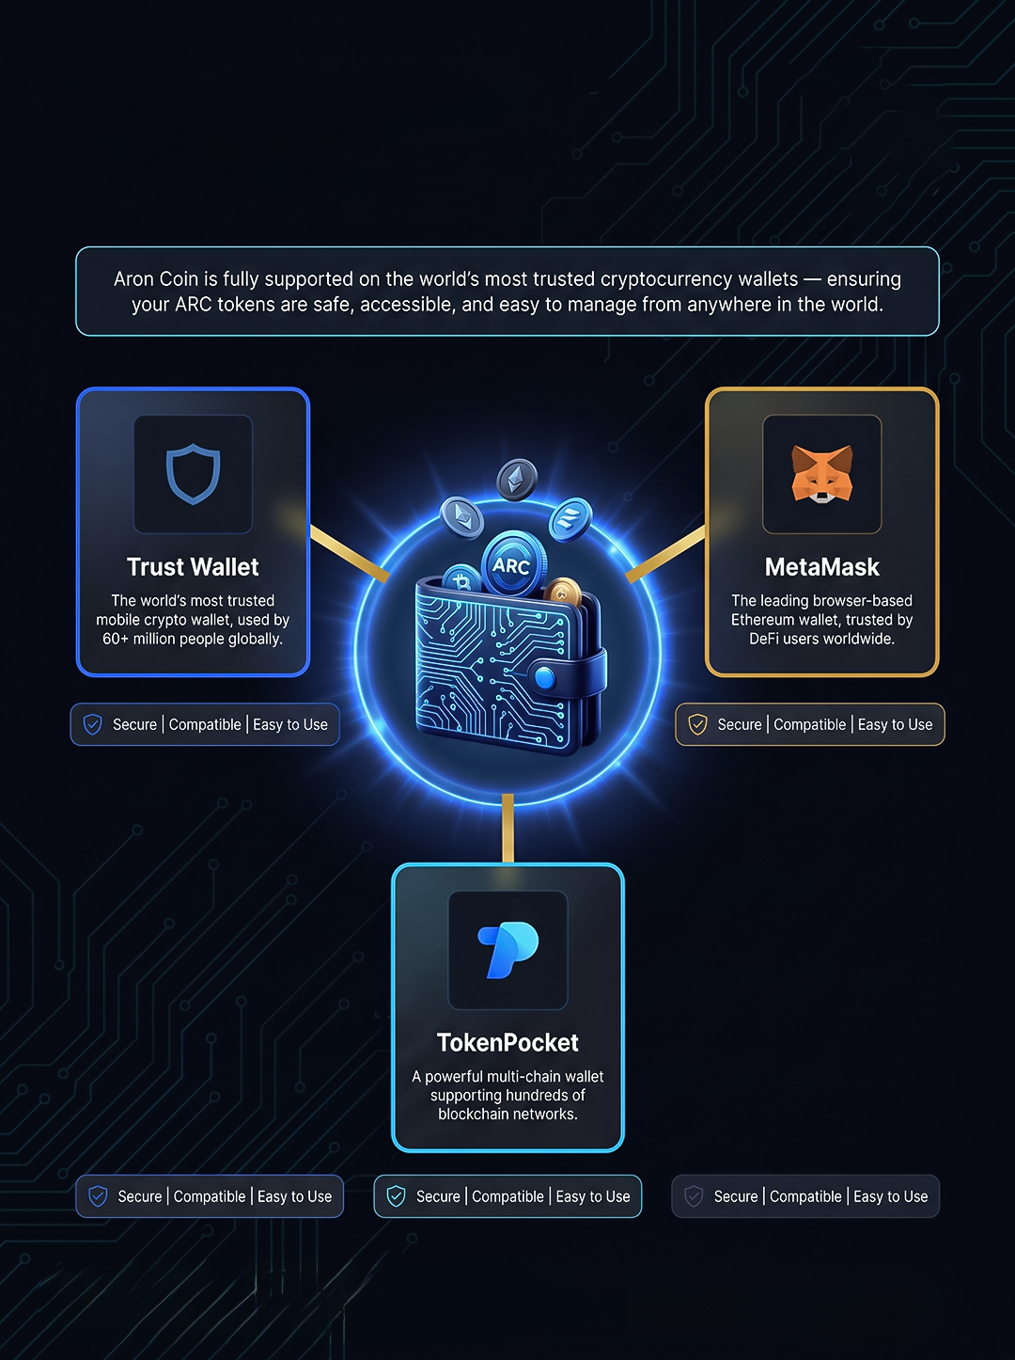
Supported Wallet
www.aroncoin.live

Slide 7
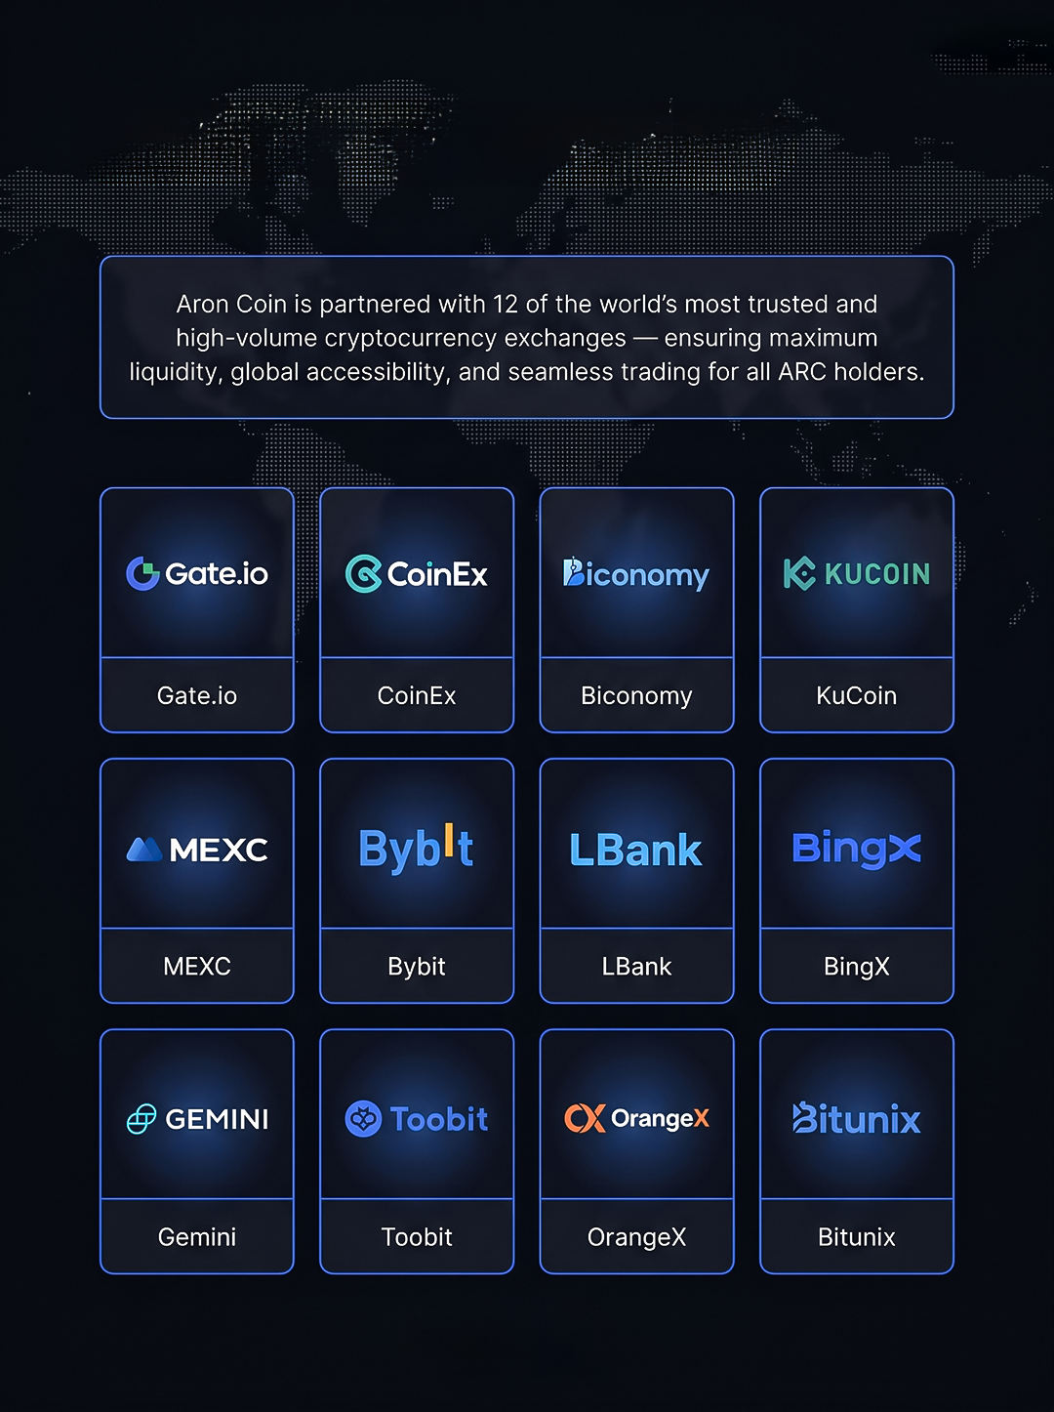
Exchange Partners
www.aroncoin.live

Slide 8

Aron Coin Listing
www.aroncoin.live

Slide 9
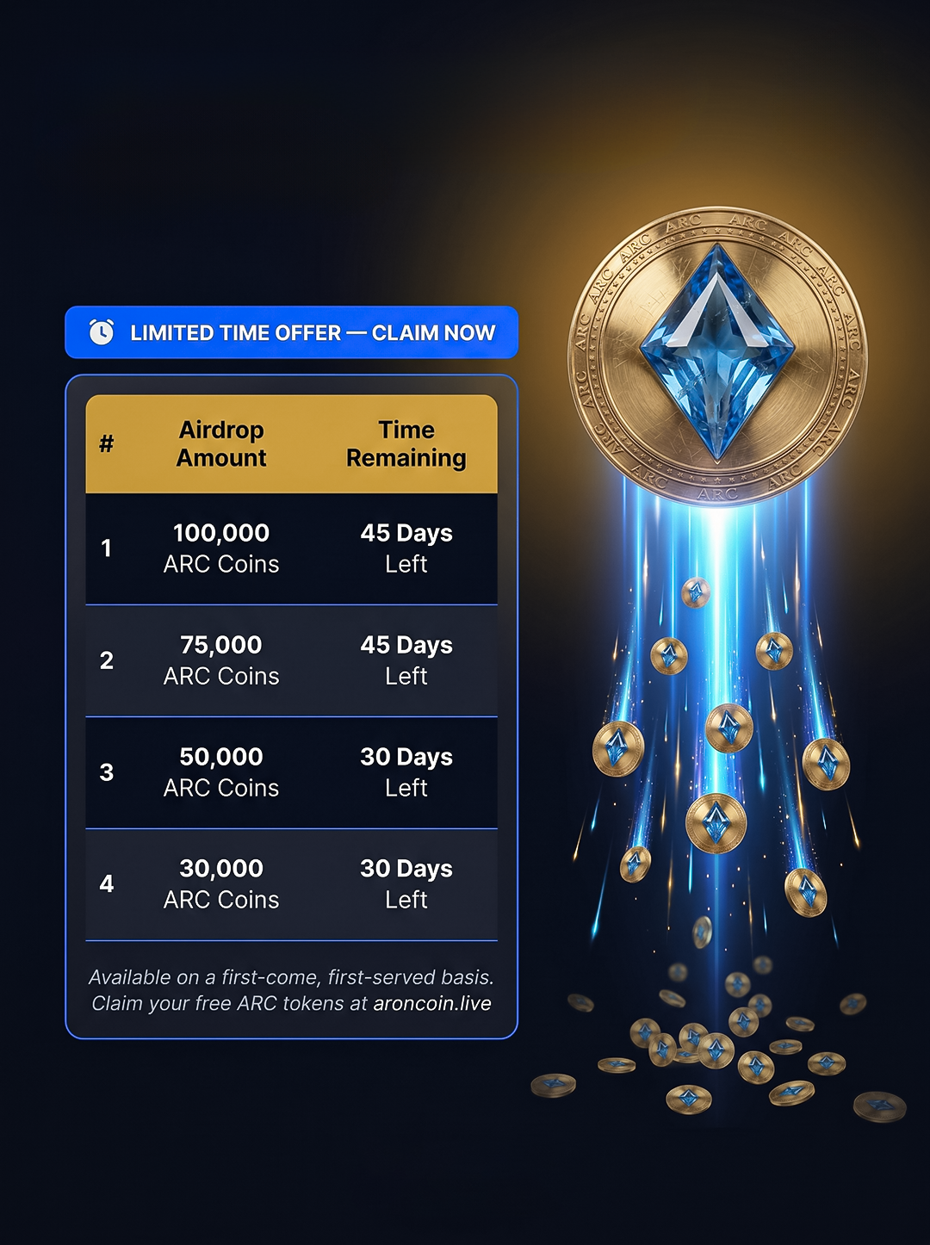
Airdrop Free Claim
www.aroncoin.live

Slide 10
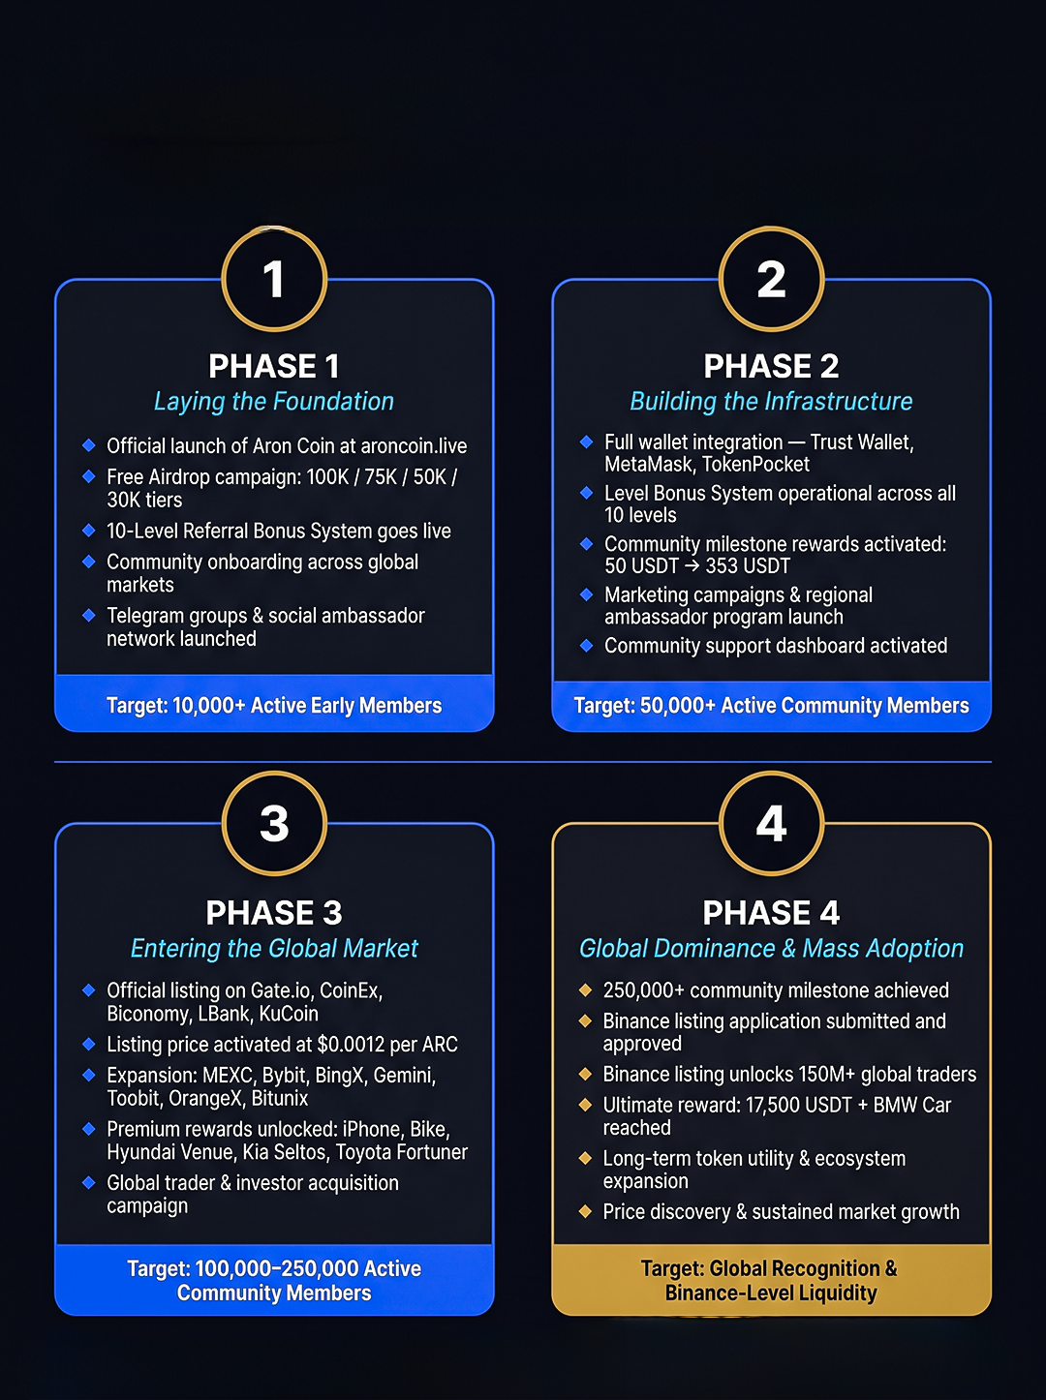
Roadmap
www.aroncoin.live

Slide 11


